Slide 1


Smart Flood Warning Agent
An Autonomous Predictive Agent for Real-Time Hydrologic Sensing, Risk Modeling, and Multi-Channel Emergency Dispatch
Course: 02AML204 – Introduction to Artificial Intelligence | Project Implementation

Slide 2

PEAS Architecture Overview
Defining Performance, Environment, Actuators, and Sensors for an Intelligent Disaster Mitigation Agent

Slide 3


PEAS Framework Breakdown
Performance Measure (P)
Actuators & Sensors (A / S)
Accurate Flood Prediction: High precision forecasting of crest levels using predictive AI models.
Actuators (A): Automated emergency SMS alerts, push mobile app notifications, and high-decibel local sirens.
Early Warning Time: Maximum advance notice window (up to 72 hrs) before critical overflow.
Sensors (S): Real-time ultrasonic water level sensors, tipping-bucket rainfall gauges, and live weather API feeds.
Low False Alarms: Noise reduction algorithms to eliminate false evacuation panics.

Slide 4
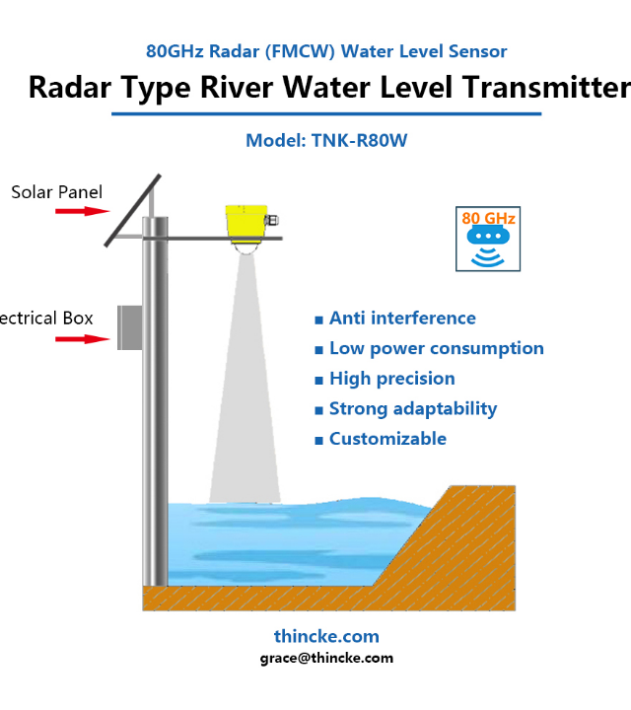
Environment & Sensors
Dynamic Operational Environment
The agent continuously operates across river basins, dam reservoirs, urban runoff channels, and meteorological data streams.
High-density IoT telemetry nodes capture hydrological fluctuations in real time, serving as the agent's primary perception mechanism.

Slide 5





IoT Sensor Data Pipeline
Water Level Nodes
Rainfall Gauges
Weather API Data
Ultrasonic and radar sensors measure river stages continuously with sub-centimeter accuracy.
Smart rain gauges track precipitation intensity and cumulative volume per minute.
Ingests satellite precipitation forecasts and upstream dam release schedules via cloud services.

Slide 6


AI Predictive Engine
LSTM & Neural Forecasting
The central AI agent uses Long Short-Term Memory (LSTM) recurrent networks trained on historical hydrological time-series data.
By evaluating non-linear relationships between upstream rainfall and downstream discharge, the agent forecasts surge levels hours in advance.
The model updates state probabilities dynamically every 60 seconds as fresh IoT sensor packets arrive.

Slide 7
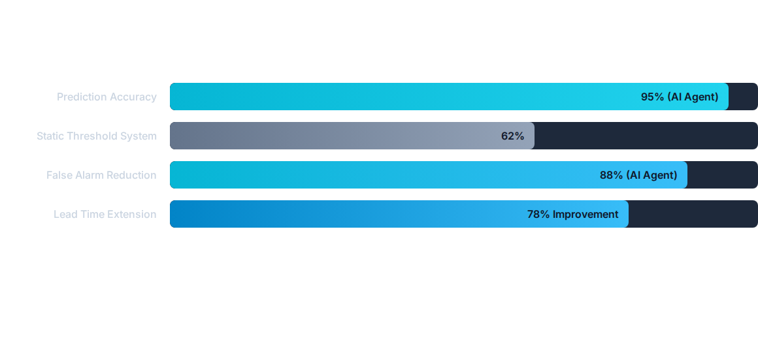
AI vs Threshold Models
The AI-driven agent significantly outperforms traditional static threshold alerts by eliminating false positives and increasing lead times.

Slide 8




Real-Time Alert Pipeline
2. Inference
4. Actuation
AI agent evaluates flood probability and severity thresholds.
Simultaneous dispatch of sirens, SMS alerts, and app notifications.
1. Perception
3. Verification
IoT nodes send continuous telemetry streams to the edge cloud gateway.
Multi-sensor cross-validation suppresses noise and false triggers.

Slide 9
Actuation Protocols Matrix
Risk Level | Flood Probability | Target Actuators | Automated Action
Low / Advisory | 10% – 30% | Dashboard & Web Portal | Log data; increment sensor polling frequency
Moderate Alert | 31% – 60% | Mobile App Notifications | Notify local authorities & emergency teams
High Warning | 61% – 85% | SMS Alerts + Mobile App | Send targeted evacuation advisories to citizens
Critical Emergency | > 85% | Sirens + SMS + Broadcast | Sound physical sirens; initiate automated evacuation

Slide 10


Performance & Impact Metrics
6 Hours
Quantifiable Protection Impact
Early Warning Lead Time
Lead Time Extension: Provides up to 6 hours of early warning prior to river stage inundation, giving authorities critical time to evacuate vulnerable zones.
Ultra-Low Latency: Ingests, processes, and acts upon emergency sensor signals in under 15 seconds across the distributed network.
< 15 Sec
Damage Mitigation: Estimated 40-50% reduction in property and infrastructure loss during flash flood events.
Sensor-to-Alert Latency

Slide 11
Technical Challenges
Network Fault Tolerance: IoT nodes utilize LoRaWAN and cellular backup to ensure connectivity during severe weather and power outages.
Sensor Calibration & Noise: AI agents apply Kalman filtering to clean noisy water level readings caused by surface waves and debris.
Power Constraints: Solar-powered microcontroller nodes use edge TinyML to reduce cloud transmission frequency and conserve energy.
Fail-Safe Mechanism: If AI predictive confidence drops below acceptable bounds, fallback rule-based safety logic takes over automatically.

Slide 12


Image Sources
https://www.thincke.com/wp-content/uploads/2024/05/Radar-FMCW-Water-Level-Sensor-for-river-01.jpg
Source: www.thincke.com
https://aigeo360.com/wp-content/uploads/2026/08/image-10.png
Source: aigeo360.com

